Slide 1

Creating a health website with a diabetes predictor
By Tamika Josiah

Slide 2
DATA SOURCE
Original source National Institute of Diabetes and Digestive and Kidney Diseases
https://www.kaggle.com/datasets/mathchi/diabetes-data-set
Data collected from Indian women in a diabetes study
Data collected on number of pregnancies, glucose and insulin levels, skin thickness, BMI, Age, Diabetes pedigree function and diabetes status.

Slide 3
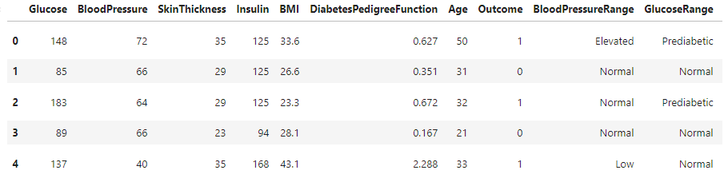
Data cleaning
Null values in skin thickness replaced by median values
Pregnancy column dropped
Created an additional column for BMI, Blood Pressure and Glucose that put the readings into categories
After cleaning 769 rows remained to train the model

Slide 4
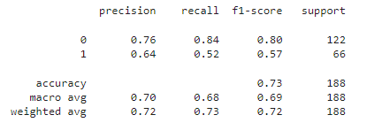
Creating a logistic regression model
A model was created to predict diabetes outcome (1 or 0) using the cleaned diabetes dataset
Classifications were converted to binary values and original columns dropped
The outcome column was selected as the target variable and all other columns were used as features
The data was split into testing and training and a logistic regression model was created.
Predictions were made using the test data and the classification report was printed.

Slide 5
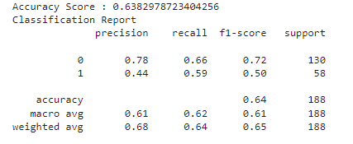
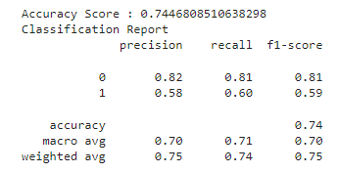
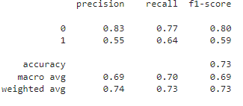
Model tuning
To try and improve the accuracy of the decision tree, random forest and k nearest neighbour models were tested. All improved the precision of the negative outcome but at a large cost of the accuracy of the positive diabetes outcome.
Decision tree
Random forest
K Nearest Neighbour

Slide 6
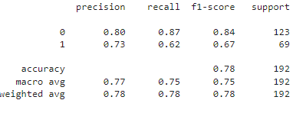
Model tuning continued
To try and improve accuracy I then repeated this process and remade the 4 models but dropped the encoded columns I had created.
The logistic regression model had the highest accuracy and precision and was then selected to be the prediction model used on the website

Slide 7
Creating the website
The website was created using the flask application, HTML and CSS files
Bootstrap was using for the navigation bar and styling

